Slide 1

MSiA 423: Cloud Engineering Final Project Airline Price Prediction
Alejandra Lelo de Larrea Ibarra - ali8110
Bannasorn Paspanthong – bpg7024
Ruben Nakano – rhn9918
Samuel Swain – sms5736

Slide 2

Business Problem
Airline ticket prices are subject to constant fluctuations due to various factors such as demand, availability, competition, seasonal trends, and economic conditions.
For airlines, having a reliable prediction system can greatly assist in:
Make informed decisions
Revenue Optimization
Customer retention
Competitive Advantage
Additionally, travelers can benefit from accurate price predictions by:
Improving the decision making
Enhancing customer experience

Slide 3
Data Science Solution
Approach:
Data Collection: Obtain comprehensive data on historic flight prices and related variables.
Data Preparation & Exploration: Clean and explore the data for insights. Enrich dataset with extra features.
Model Development & Training: Train selected machine learning models on data.
Model Evaluation & Validation: Evaluate models’ hyperparameters using validation accuracy.
Model Deployment: Integrate the model into travel agency's website.
Benefits:
Essay access for customers to plan their travel expenses more effectively, and
The travel agency can attract more customers by enhancing their user experience.
Goal:
Develop a predictive model to forecast airline ticket prices and deploy the solution as a web application.

Slide 4
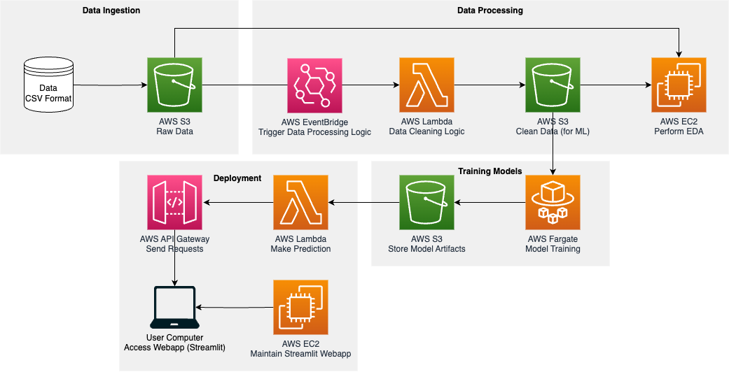
Architecture Diagram
1
Data Ingestion
Assume Receiving new data in csv format.
Upload new data into AWS S3 bucket to keep record of raw data
Assume constant new data at 1GB per month
Data Processing
AWS EventBridge
Trigger data processing pipeline when new data gets added to raw data S3 bucket.
AWS Lambda
Code to clean data
Assume cleaning data once a day (triggered 30 times per month)
AWS S3
Store clean data for training machine learning models
AWS EC2
Notebook to perform EDA (receive both raw data and clean data to understand data)
1
2
2
4
3

Slide 5
Architecture Diagram
3
Training Models
AWS ECS Fargate
Assume training model once a day
60 minute to train models
16 GB memory
AWS S3
Store model artifacts
Deployment
AWS EC2
Maintain Streamlit WebApp
Constant usage (24/7)
t3a.medium
On-demand
AWS API Gateway
At most 2 million requests
Both HTTP and REST APIs
AWS Lambda
Assume 2,000,000 predictions per month
512 MB memory
Average at 10 seconds for making a prediction
1
2
4
4
3

Slide 6
Ideal Timeline
Phase 1 (Pilot)
Business Understanding
Data Collection
Modelling
MVP Deployment
A/B Testing
Phase 2 (Real Time Global Inference)
Acquire More Data
Model Retraining
Deploy in Travel Agency Website
Monitor Model Performance
Continuous A/B Testing

Slide 7
Data Collection and Preparation
Data from website easemytrip.com (available on Kaggle)
Flights between India’s top 6 metropolitan cities
Approximately 300,000 data points
9 features:
airline, flight number, seat type, departure time,
arrival time, origin, destination, number of stops, and flight duration.
Approximately 25 MB
Collected from Feb 11th, 2022 to Mar 31st, 2022. (50 days)

Slide 8
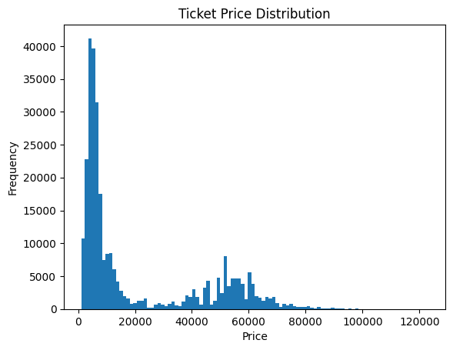
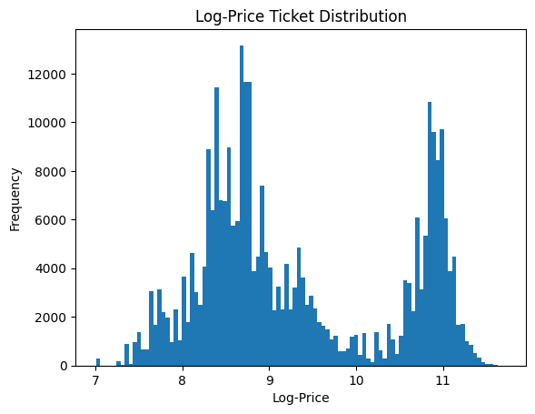
Main EDA insights
Price is very right skewed and bimodal.
Our data processing steps will log transform ticket prices.

Slide 9
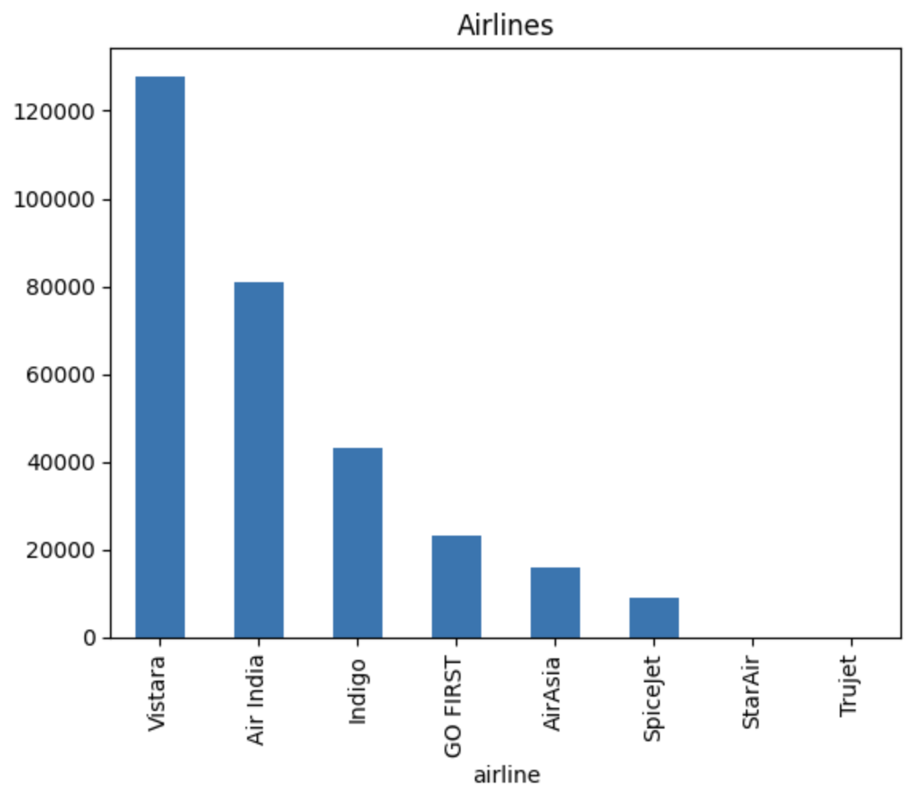
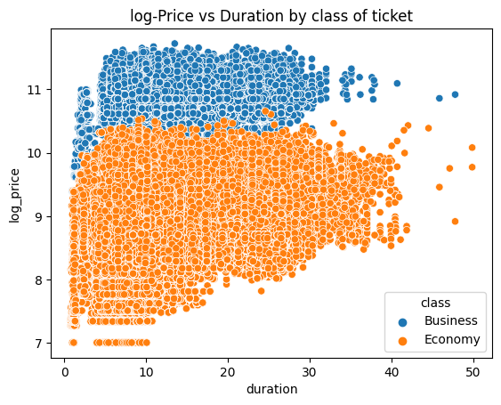
Main EDA insights
Due to the lack of data, we will exclude StarAir and Trujet
Clear log price distinction between economy and business class

Slide 10
Model Building & Training
Single pipeline with modular functions run in ECS
Feature transformation (log price and filter airlines)
One-hot encode categorical variables
Train-test split and fit 3 different models
Evaluate model metrics
Save models and configurations in S3 bucket
Model | R-squared | RMSE
Linear Regression | 0.903 | 0.347
Random Forest | 0.902 | 0.347
XGBoost | 0.916 | 0.322

Slide 11
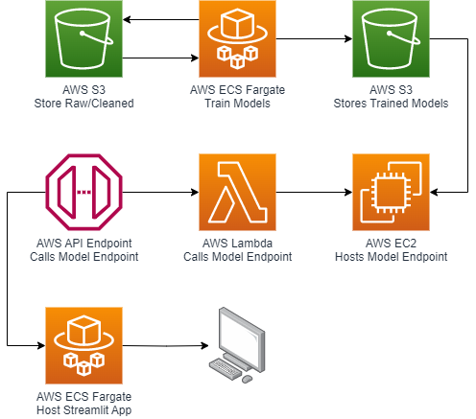
Model Deployment
Model Training: Linear Regression, Random Forest, Xgboost
Flask API: Model hosting & predictions
AWS EC2: Flask API hosting
Streamlit: User interface creation
Docker: Streamlit app containerization
Lambda/API Endpoint: API to Lambda connection & model endpoint calls
AWS ECS: Docker image deployment

Slide 12







Cost Estimation (Business Version)
link
Service | Description | Monthly | Monthly per Service | Yearly | Yearly per Service
API Gateway | Send requests to make predictions | $ 9.00 | $ 9.00 | $ 108.00 | $ 108.00
EC2 | EDA Maintain WebApp | $ 45.34 $ 274.48 | $ 319.82 | $ 544.08 $ 3,297.60 | $ 3,841.68
EventBridge | Trigger Data Processing | $ 6.40 | $ 6.40 | $ 76.8 | $ 76.8
S3 | Raw Data Clean Data Model Artifacts | $ 0.03 $ 0.10 $ 0.07 | $ 0.20 | $ 0.36 $ 1.20 $ 0.84 | $ 2.40
ECS | Model Training | $ 7.09 | $ 7.09 | $ 85.08 | $ 85.08
Lambda | Data Cleaning Model Prediction | $ 0.00 $ 160.51 | $ 160.51 | $ 0.00 $ 1,926.12 | $ 1,926.12
Total |  | $ 503.02 |  | $ 6,036.22

Slide 13
Cost Estimation: Details
AWS API Gateway
Max 2 million requests per month (HTTP and REST APIs)
AWS Lambda
2,000,000 predictions per month
Average 10 seconds per prediction
512 MB memory allocated
AWS EC2
t3a.medium
2vCPU
4 GiB Memory
100% Utilization
10 instances
AWS ECS Fargate
30 tasks per month
60 minutes per task
4vCPU
16 GB memory

Slide 14

Web Application Live Demo

Slide 15

Github Repo
https://github.com/AlejandraLLI/Cloud_Engineering_Project/tree/main

Slide 16

Appendix

Slide 17
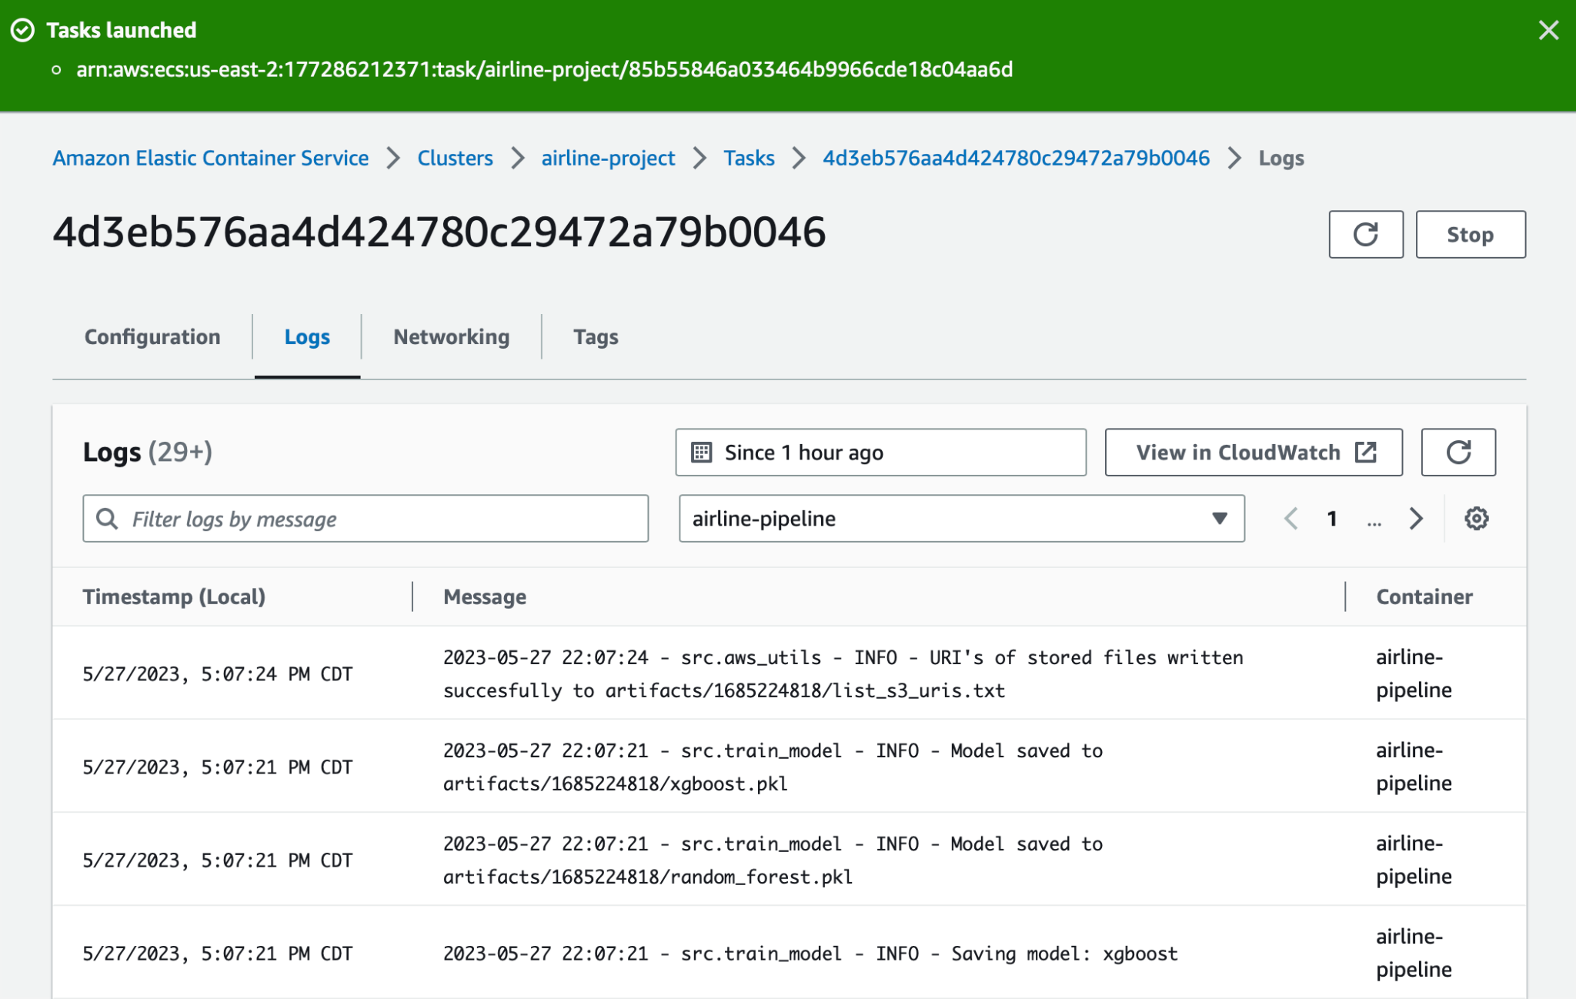
Appendix

Slide 18
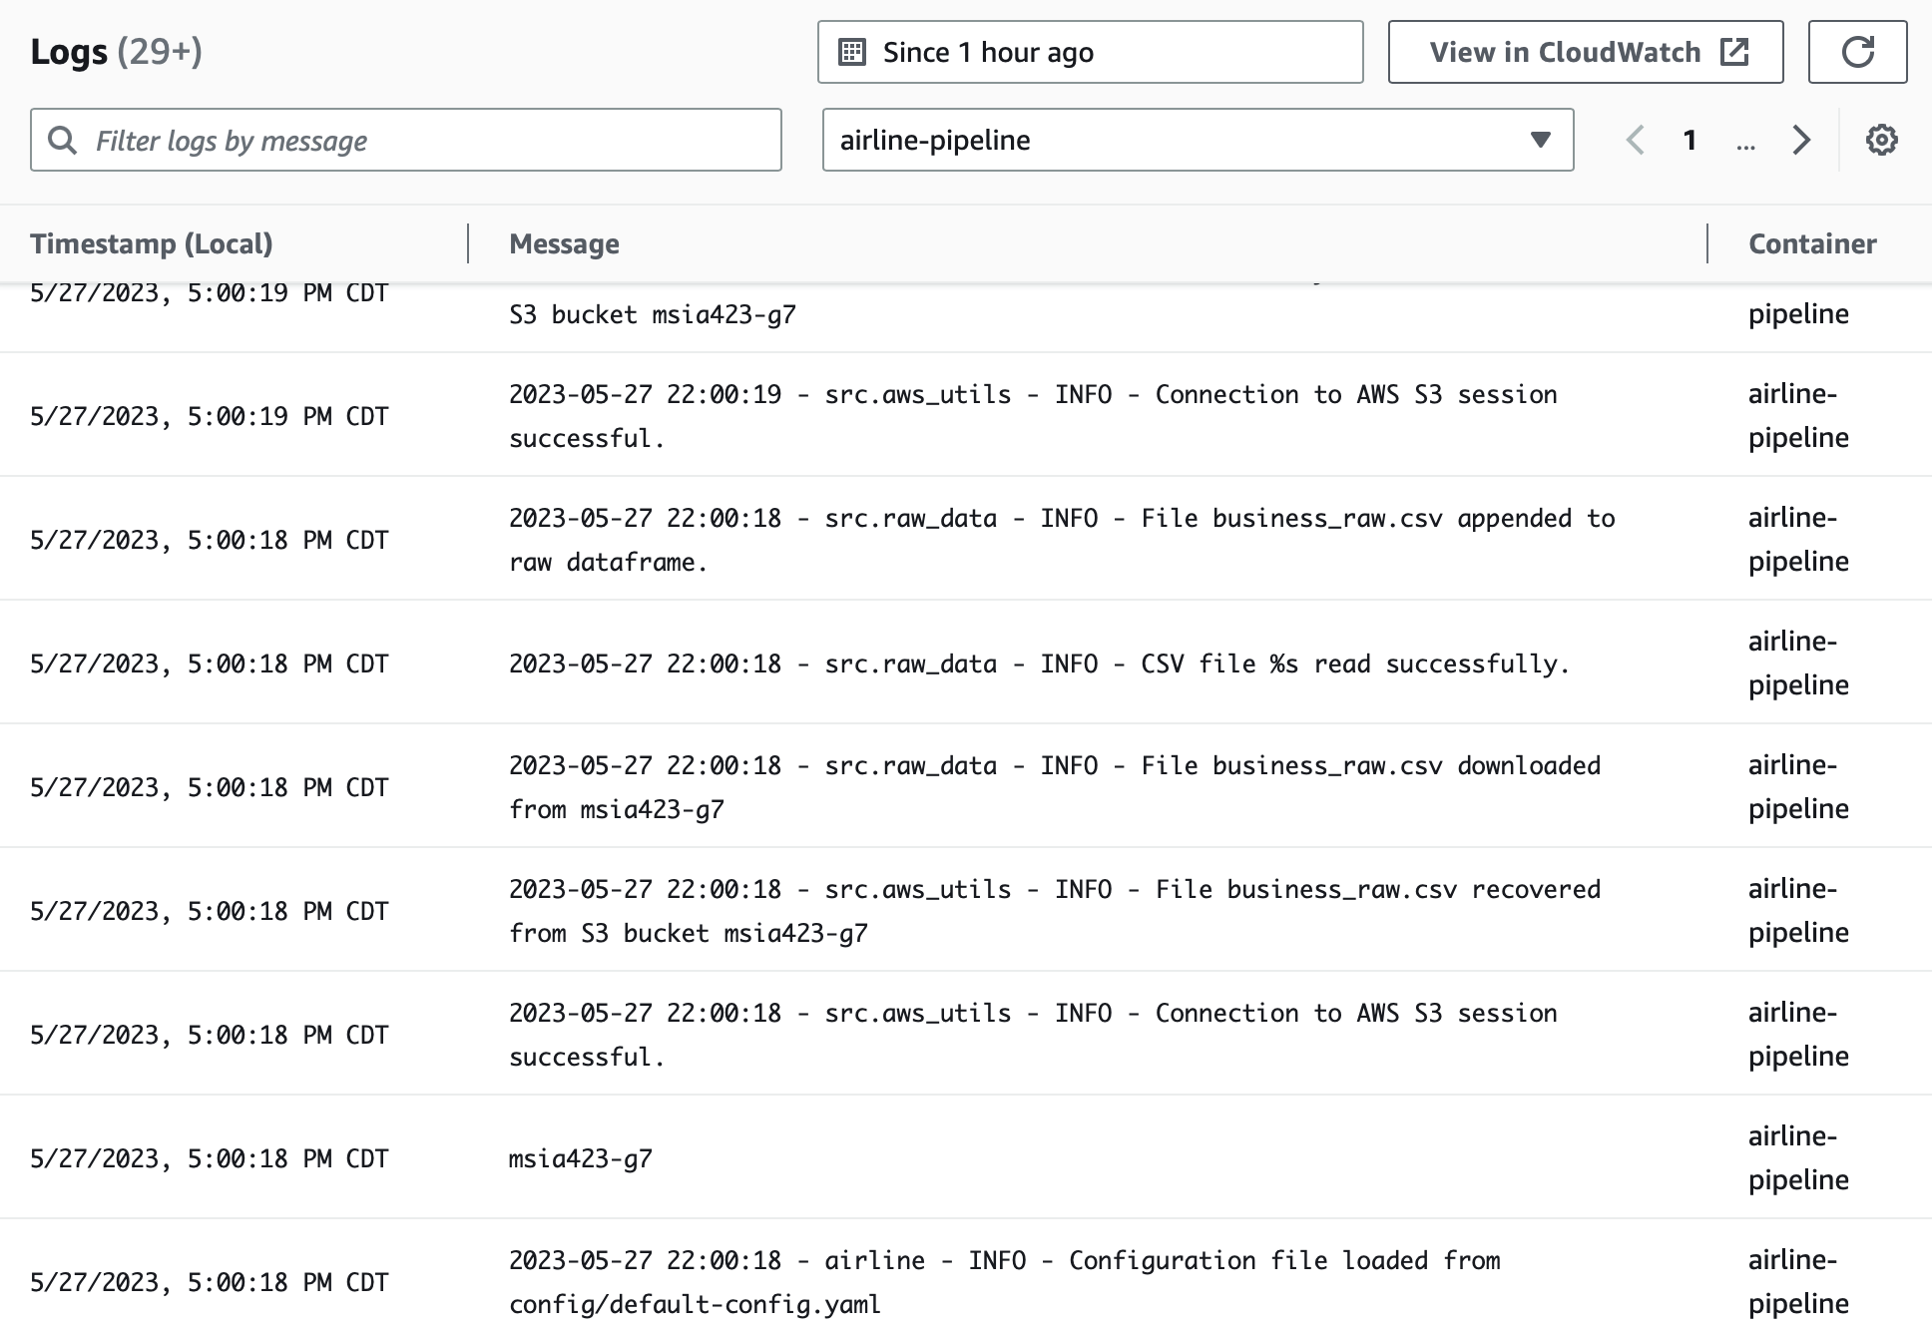
Appendix

Slide 19

Web App Demo

Slide 20
